Slide 1



Hacking WikidatA
Inside the biggest Open Knowledge database \o/
Exploring Linked Data & SPARQL queries
by #bozz and #CristianConsonni
gnu@linux.it
Linux.it- ILS.org

Slide 2
Wikidata in 25 seconds
“Open” means:
→ Released in Creative Commons Zero
“Knowledge Base” means:
→ Collection of statements
«Mount Everest has height 8,848.86 M.»
“Biggest” means:
→ 107.4 million items
→ 1 998 116 547 edits
“Multilingual” means:
→ ~318 languages
YES: Lumbard included
https://lmo.wikipedia.org/
“Collaborative” means:
→ Quick data entry, even anon.
→ 23K active users
https://www.wikidata.org/wiki/Wikidata:Statistics
Linux.it- ILS.org
Notes:
Contatore accessi

Slide 3
Cristian Consonni
Notes:
Contatore accessi

Slide 4
Cristian Consonni
Physics
Notes:
Contatore accessi

Slide 5
Cristian Consonni
Studied
Physics
Notes:
Contatore accessi

Slide 6
Cristian Consonni
Studied
Physics
Earth
Studied by
Notes:
Contatore accessi

Slide 7
Cristian Consonni
Studied
Physics
Mount Everest
Earth
Is located
Studied by
Notes:
Contatore accessi

Slide 8
Cristian Consonni
George Everest
Studied
Named after
Physics
Mount Everest
Earth
Is located
Studied by
Notes:
Contatore accessi

Slide 9
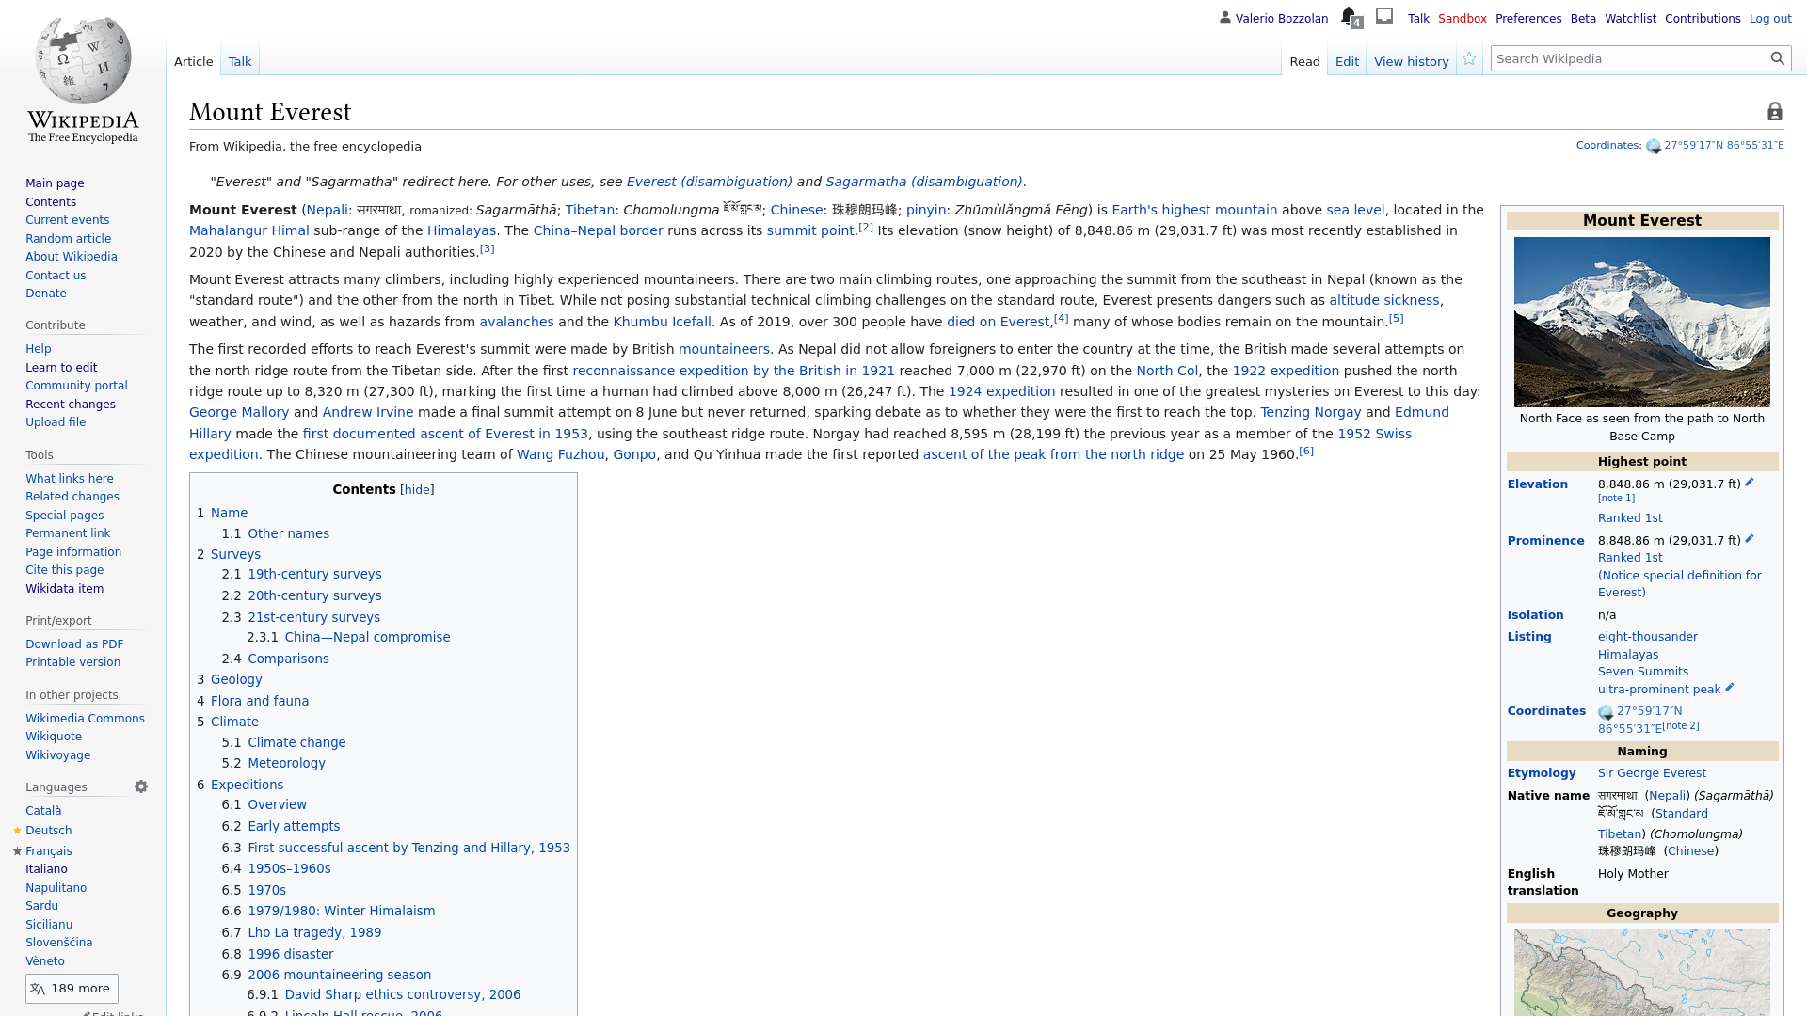
Wikipedia vs
Wikidata
Linux.it- ILS.org
Notes:
Contatore accessi

Slide 10
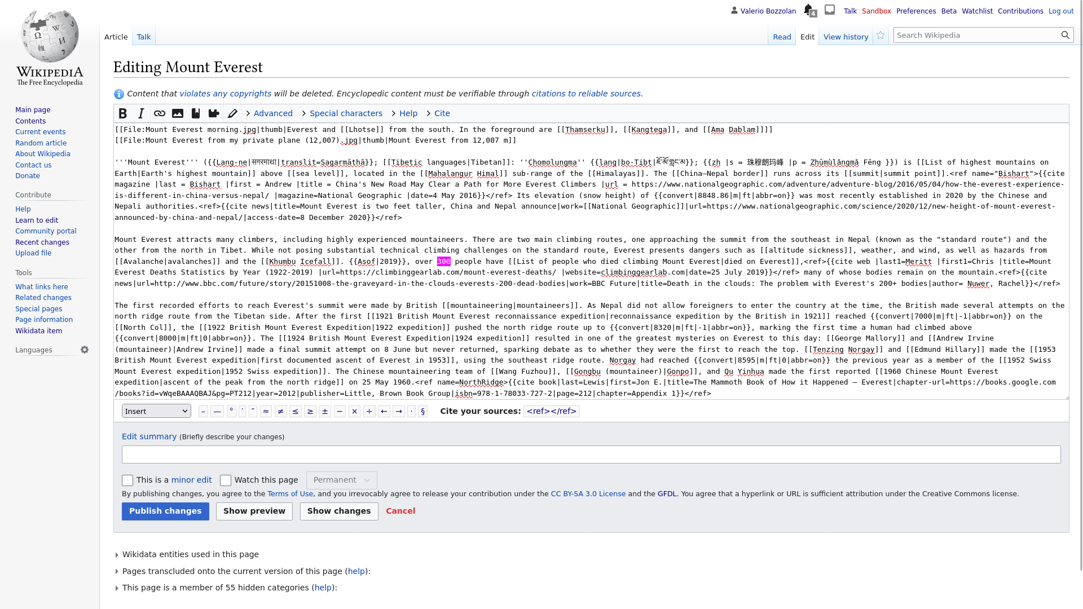
Wikipedia
→ encyclopedia
Core: freetext
Linux.it- ILS.org
Notes:
Contatore accessi

Slide 11
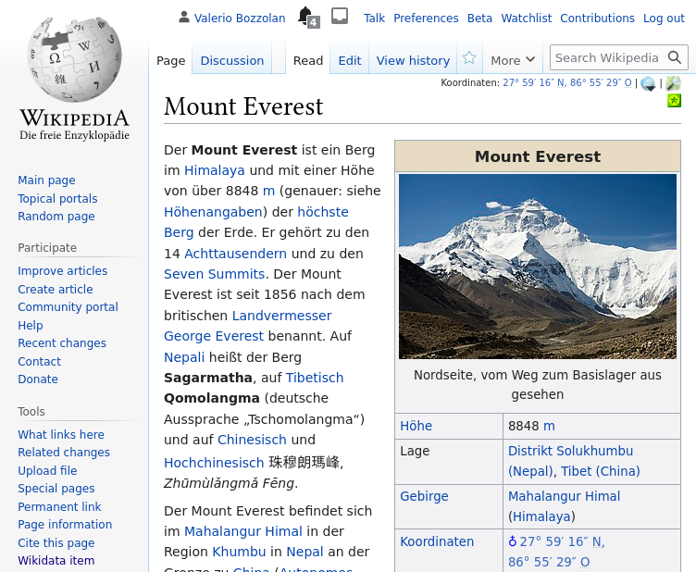

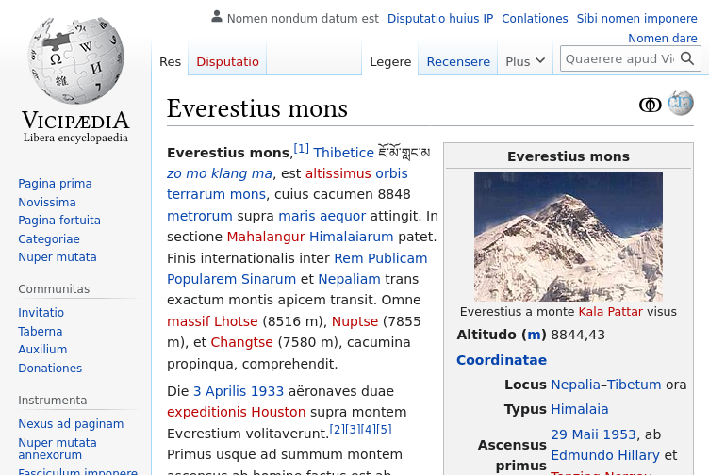
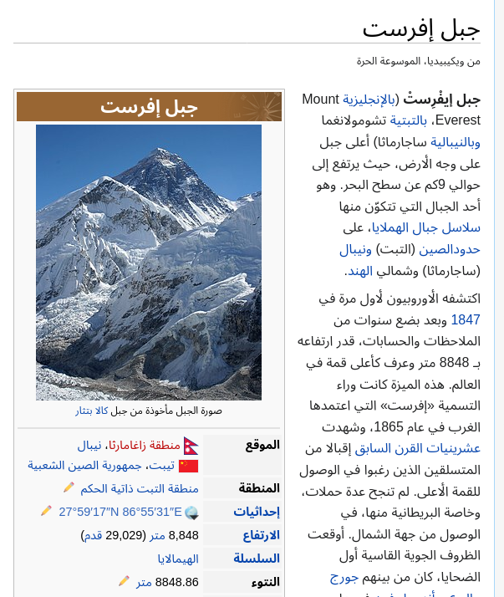
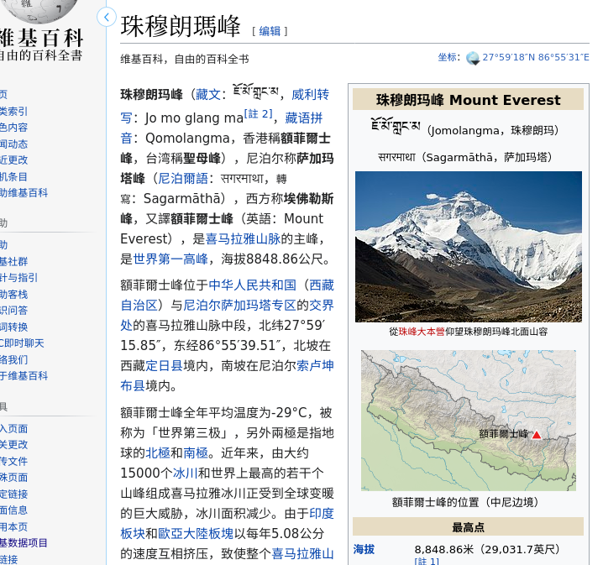
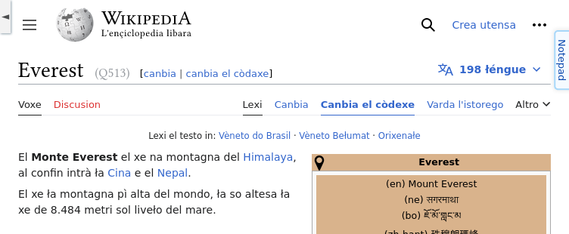
Linux.it- ILS.org
Notes:
Contatore accessi

Slide 12
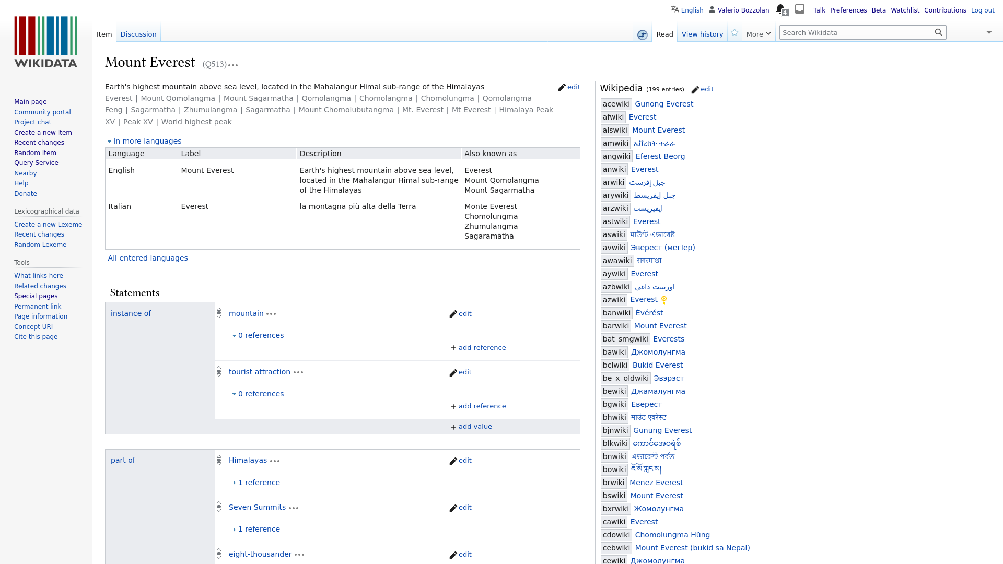
Wikidata
→ database storing structured claims
Linux.it- ILS.org
Notes:
Contatore accessi

Slide 13
If an information is on Wikidata
→
Wikimedia projects can read that information in real-time.
...
...
Linux.it- ILS.org
Notes:
Contatore accessi

Slide 14
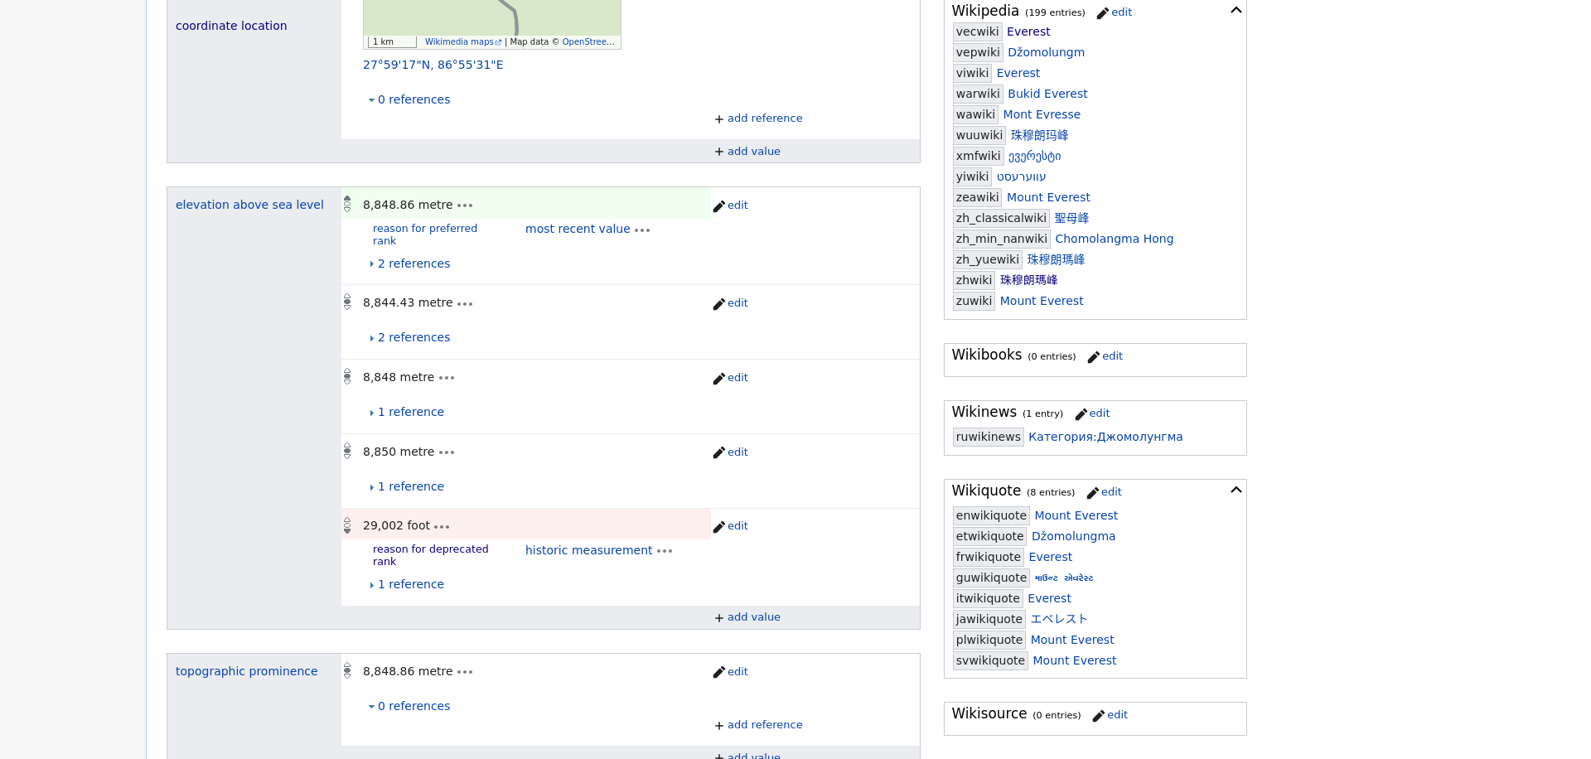
Wikidata
→ example Statement(s)

Slide 15
Wikidata
→ example Statement(s)

Slide 16
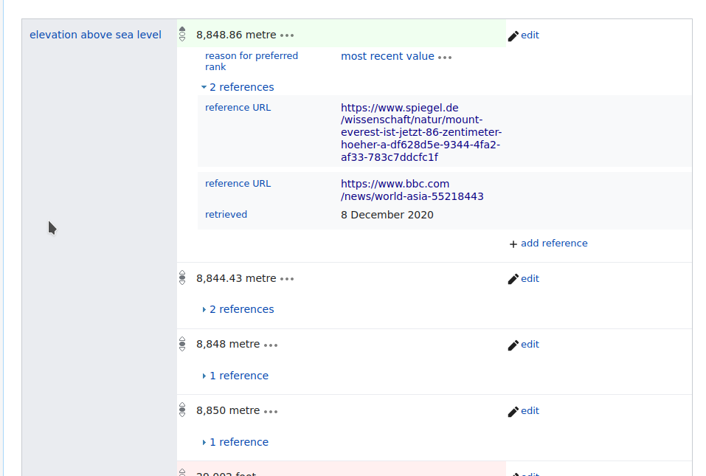
Wikidata
→ example Statement(s)

Slide 17
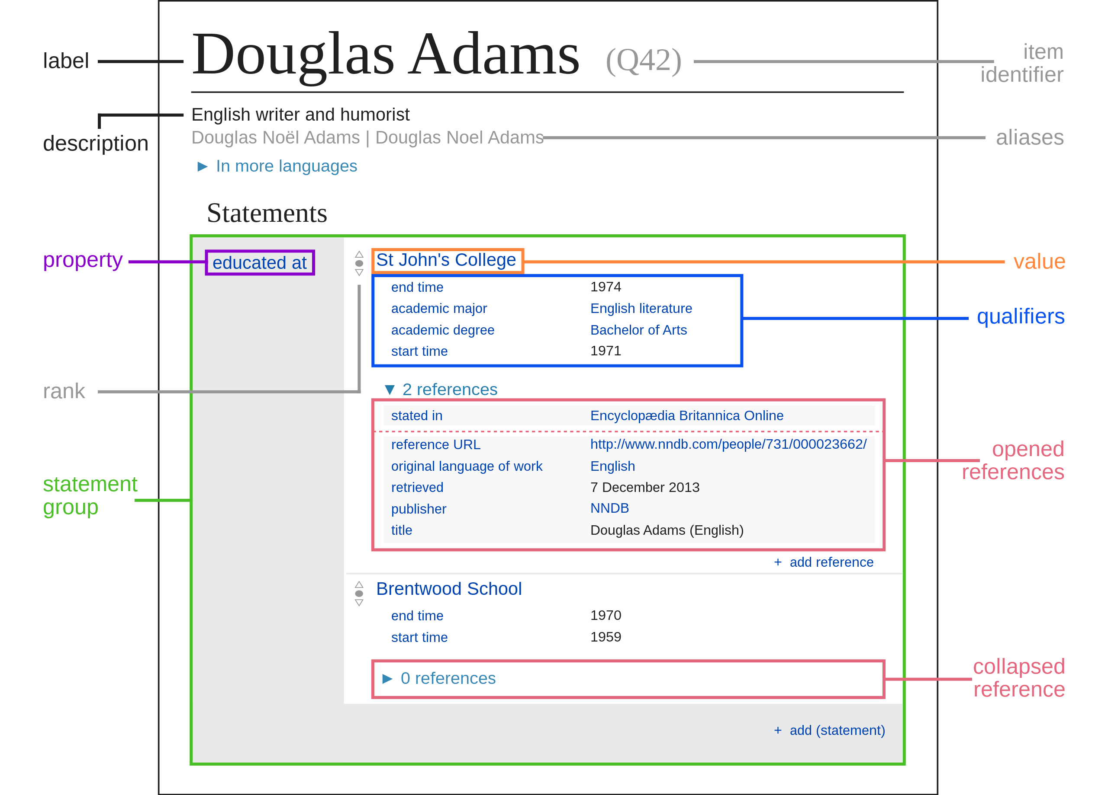
Notes:
Contatore accessi

Slide 18
Querying data from Wikidata
SELECT ?value WHERE {
?mountEverest ?hasHeight ?value.
}
↑ that’s SPARQL
Linux.it- ILS.org
Notes:
Contatore accessi

Slide 19
Subject · Predicate · Object
SELECT ?value WHERE {
?mountEverest ?hasHeight ?value.
}
↑ subject
↑ object
↑ predicate
Linux.it- ILS.org
Notes:
Contatore accessi

Slide 20
Bonus Level
https://etherpad.wikimedia.org/p/LinuxDayMilano2023
↑ Batteries included

Slide 21
Bonus Level²
How to phcontribute to phource phode
Wikimedia Phhhhhhabricator!
https://phabricator.wikimedia.org/tag/wikidata/
↑ Batteries not included

Slide 22
Credits and Free licenses
File:Datamodel_in_Wikidata.svg.png
CC0 by Charlie Kritschmar (WMDE)
https://commons.wikimedia.org/wiki/File:Datamodel_in_Wikidata.svg
File:Wikidata.svg
CC0 by 17jiangz1
https://commons.wikimedia.org/wiki/File:Wikidata.svg
Notes:
Contatore accessi

Slide 23
Let’s see some stuff
Help tools:
- https://www.wikidata.org/wiki/Wikidata:Introduction
- “Wikidata:SPARQL query service”
Cristian
cristian.consonni@wikimedia.it
Valerio
gnu@linux.it
Linux.it- ILS.org
Notes:
Contatore accessi

Slide 24
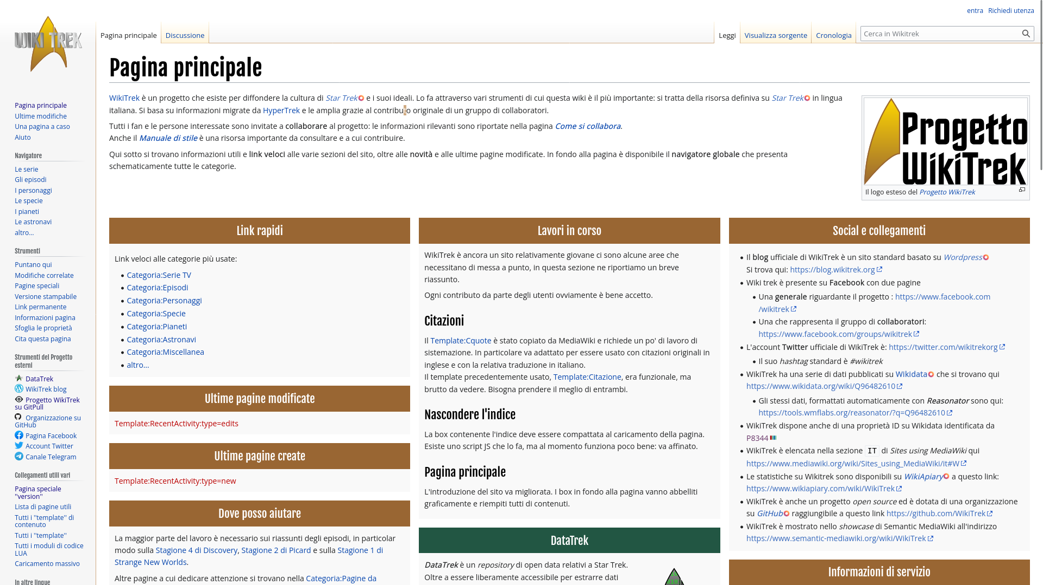

Slide 25


